Slide 1
Critical Reflection Presentation
Drew Weinstein
AICE Media studies

Slide 2
Critical reflection question 1
How does your product use or challenge conventions and how does it represent social groups or issues?
My magazine cover challenges conventions in many different ways. To begin with I made each little piece of information included on the magazine cover a different color. I used brighter and more vibrant colors because the background was dark so I knew it would pop. I did this to make each detail stand out and grab the audience’s attention. Another way I used conventions was by making the more significant words catch the eye of the audience, by making those words a larger or different font than the rest of the words in that sentence. For example, I stated there were “15 new dessert ideas”. I made the 15 a larger font so the audience would notice that first and become interested, I also made the sentence a pastel pink because I know that color will grasp the audience’s attention. I also centered the photo on the cover to make the ice cream one of the first things the audience notices when they look at the magazine.
My magazine represents certain social groups or issues by providing desserts for everyone’s cravings. On my magazine cover I mentioned how there is “a little something for everyone”. This sends a across a message implying there will be a wide range of tasty desserts for everyone’s likings. I also included another cover line mentioning that there are “10 delicious vegan desserts”. This targets people who cannot eat specific foods, this is a very effective way to grab the audience’s attention because it targets certain people with strict diets. Vegans would especially be pulled towards this magazine because it’s not as common to find magazines that would include recipes to satisfy their diet. On another cover line l mentioned that there are “easy 5-minute homemade desserts”. This mainly applies to the social group that doesn’t have much free time throughout the day. These easy desserts can help those people still provide themselves and others with flavorful sweets, despite their busy lives.

Slide 3
Critical reflection question 2
How does your product engage with audiences and how would it be distributed as a real media text?
My product engages with audiences by offering the most delicious and simple homemade desserts with the audience’s lifestyle and interests taken into consideration. When making my magazine cover, I inserted a picture of a food that is commonly enjoyed attempting to grab many people’s attention. Although I did target some specific social groups overall this magazine is meant for people with all different types of passions. For example, people with busy lives, strict diets, and even people who enjoy trying new things can all enjoy this magazine and find something that satisfies their interests. I included multiple coverlines explaining some of the things that my magazine includes, which allows these certain audiences to be interested in my magazine and want to look further into it. I can also engage with audiences through putting my product on social media. This can allow the product to be viewed by many different age groups and a multitude of people with different interests.
My product would be distributed as a real media text in many different ways. The first way I can distribute my product would be at shops. This a very effective way because most people will notice the magazine and can possibly be interested in purchasing it. Since my magazine is a dessert magazine it would be the most effective to distribute mine to supermarkets and grocery stores. This is because there is a higher chance someone would be interested purchasing a food magazine at a location where food is sold rather than where something else that isn’t related to food is sold. Another effective way to distribute my magazine would be online. There are many ways to distribute a magazine online, but the most effective way would be through social media. This is because there is a wide variety of people with different interests and ages. Specifically, Facebook can be a great way because my magazine targets a older audience and Facebook contains that, this is a very easy way to do this because such a large amount of people have social media which can allow more people to purchase my product

Slide 4
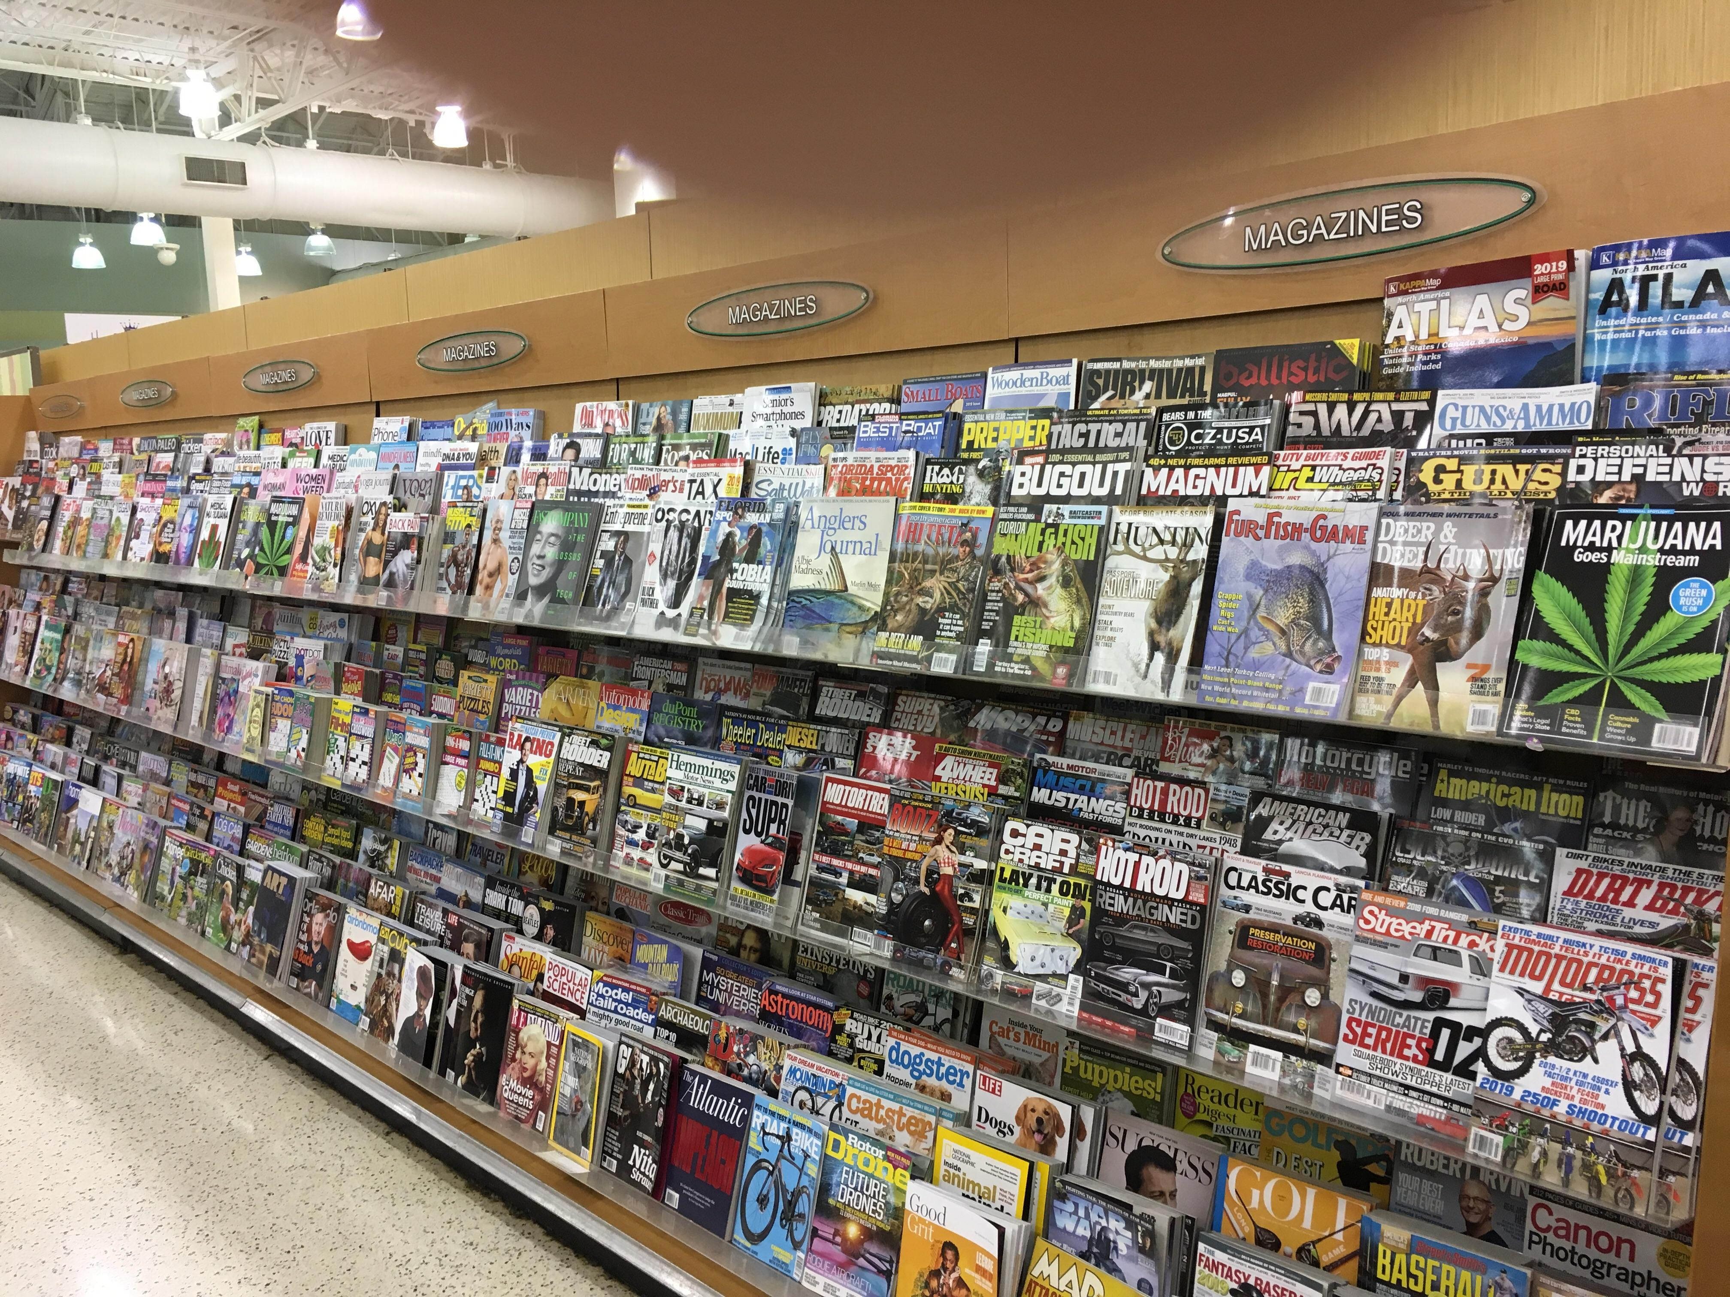
My magazine cover is a picture of a cupcake, this magazine fits well here because people go to Publix to purchase food and they may be more interested in a magazine with food on the cover rather than anything else.
These are magazines being sold at Publix, which is one of the ways I can sell my magazine.

